Slide 1

An MTech. Dissertation Preliminary Presentation On Posting Comments Under Differential Privacy
Submitted By :
Nihar Sodhaparmar
P22CS013,
M. Tech., DoCSE, SVNIT
Guided By :
Dr. Sankita J. Patel
Assistant Professor,
DoCSE, SVNIT

Slide 2
Outline
Introduction
Theoretical Background and Literature Survey
Implementation Methodology
Experiments
Results
Conclusion and Future Work

Slide 3
Introduction
Vast amount of data produces on Online Social Networks everyday.
Users uses various platforms like Facebook, Instagram, Twitter, LinkedIn, Twitter, Reddit etc. for communication, connect with other, share daily activities.
Users knowingly or unknowingly disclose personal information publicly with friends and strangers.
These data exposes individuals’ privacy, users to tracking, making them extremely vulnerable to potential threats.

Slide 4
Introduction
Adversaries infer personal information of users like age, gender or political affiliation.
Despite from users data, non user generated data (e.g. comments by friends, friends of friends or other users) is also determine sensitive attributes.
It is essential for publishers of social media data to protect users' privacy.
In this work we will see the attacks possible on the users data and study the various mechanisms to provide privacy to users. Then, we will provide the Posting Comments Under Differential Privacy to hide gender sensitivity of users.

Slide 5
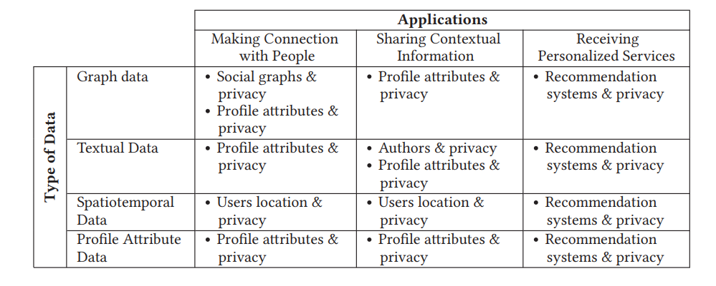
Theoretical Background and Literature Survey
Figure : Combination of Various Data Types and Applications [1]

Slide 6
Theoretical Background and Literature Survey
Two types of attack possible on users data
Identity Disclosure Attacks – It occurs when an individual is mapped to an instance in a released dataset.
Attribute Disclosure Attacks – It occurs when the adversary could infer some new information regarding an individual based on the released data.
Users are at very much risk from attribute inference attacks, which utilizes machine learning models to private information such as gender or age.
We will see the attribute inference attacks on the user data.

Slide 7
Theoretical Background and Literature Survey
Attribute Inference Attacks
User’s profile may contain self-identifying attributes, such as age, gender, visited places, and political viewpoints, which could be infer by potential attackers.
Types of Attribute Inference Attacks
Friend based Attribute Inference Attacks
Friend based techniques follows the method that two friends are more probable to share similar attributes rather than two strangers.
In [2] authors estimated the ages of Facebook users by taking into account the details of their friends networks. Also used the year they graduated from high school to infer their birth year.
Behavior based Attribute Inference Attacks
Behavior based inference attacks infer a user’s attributes based on the publicly available information regarding users behaviors and public attributes of other users similar to user.
In [3] authors present method that uses user behavior toward movie ratings to infer features (such as gender) about users.

Slide 8
Theoretical Background and Literature Survey
Friend and Behavior based Attribute Inference Attacks
It uses behavior and social links to infer characteristics about the user.
In [4] authors created a social-behavior-attribute network (SBA) using social structure, behaviors and characteristics of users all combined into a single framework to characteristics of users.
Non User Generated Data based Attribute Inference Attacks
Created by individuals other than the primary user
It includes reactions made on the user’s posts by their friends or friends of friends.
In [5] authors uses alt-text generated by Facebook to describe picture content, as well as comments with words and emojis posted by friends, friends of friends, or other users.
Now, we focus to fool the classifiers to predicts the attributes.

Slide 9
Theoretical Background and Literature Survey
Method | Approach | Limitations
DeepWordBug [10] | Making characters level transformations to fool deep learning classifiers. | Adversial changes can be easily visible because of simple character level transformations
TEXTBUGGER [9] | Making Minimal alterations to the words for attacking deep learning models. | Adversarial changes are easily detectable by individuals due to the minimal alterations to the words.
MALCOM [8] | Generating adversial comments to attack neural fake news detections. | Proposed for only fake news detection, Other users have to add manually adversial comments on fake news article.
FOX [7] | Generating adversial comments to fool gender attribute inference classifiers. | Others users have to add manually comments on the Facebook post.
Table: Comparison of different approaches to fool classifiers

Slide 10
Theoretical Background and Literature Survey
In [6] authors proposed to hide sensitive information of text from Machine Learning models using Differential Privacy.
It suggest a sanitization aware pretraining approach.
First, sanitizes public text and then they train Machine Learning models on sanitize text to fool classifiers.
From FOX Paper [7] and Differential Privacy Paper [6] we took inspiration and proposed an approach Posting Comments Under Differential Privacy to fool attribute inference classifier.
First, we will see the different terminologies for Differential Privacy.

Slide 11
Theoretical Background and Literature Survey
Differential Privacy
User possesses a document D = ⟨x_{i}⟩ (i = 1 to L) of L tokens (each of which could be a character, word, subword or an n-gram), where x_{i} is drawn from the vocabulary V of size |V|. To protect privacy, user generates a sanitized version D’ by employing a common text sanitization mechanism M on their local devices over D. M replaces each token x_{i} in D with a substitute token y_{i} ∈ V.
Local Differential Privacy
With a privacy parameter ε ≥ 0, the mechanism M satisfies ε-local differential privacy (ε-LDP) under the condition that, for any x, x′, y ∈ V
Smaller ε provides better privacy but outputs of x and x′ must be same regardless of how unrelated they are

Slide 12
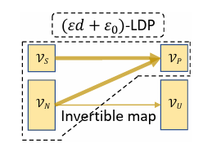

Theoretical Background and Literature Survey
Metric-LDP (MLDP)
For any ε ≥ 0 and a distance metric d : V × V → R ≥ 0 over V, the mechanism M satisfies MLDP for any x, x′, y ∈ V
Utility optimized MLDP
In MLDP all tokens are consider as sensitive
ULDP divides input space into sensitive V_{s} and non sensitive V_{n} tokens, where as output space into protected V_{p} and unprotected V_{u}.
Sensitive x ∈ V_{s} can only be substituted with protected words y ∈ V_{p}
Non sensitive words x ∈ V_{n}, mapping to V_{p} is allowed, but every substitution y ∈ V_{u} must originate from V_{n}

Slide 13
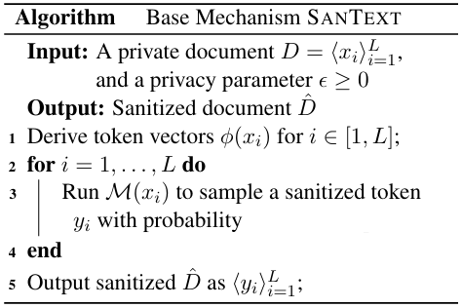
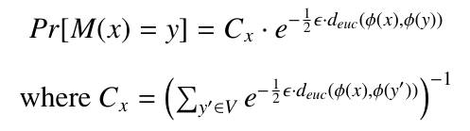
Theoretical Background and Literature Survey
SANTEXT Mechanism
First, using φ convert the each token x of
document D into token embeddings
Then, in the second step for each token x
run a sanitizing mechanism M(x) with
probability
SANTEXT Algorithm [6]

Slide 14
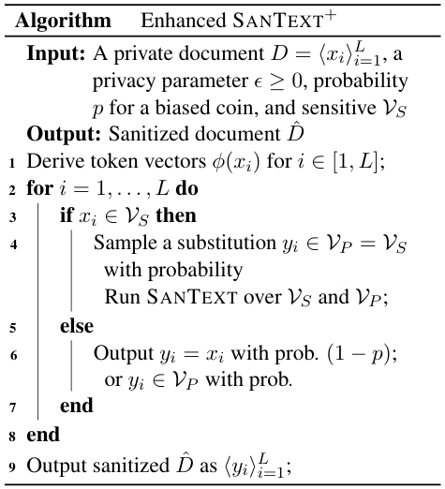
Theoretical Background and Literature Survey
SANTEXT plus Algorithm [6]

Slide 15
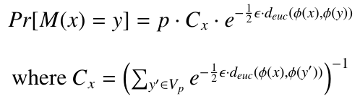
Theoretical Background and Literature Survey
In first step, using φ convert the each token x of document D into token embeddings.
If token x belongs to V_{s}, sample the substitution of y from V_{p} according to the probability specified in the SANTEXT algorithm.
For x ∈ V_{n}, flip a bias coin. If the result is (1 − p) outputs y as x. Otherwise, samples y ∈ V_{p} with probability

Slide 16
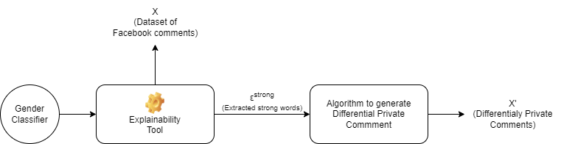
Implementation Methodology
Figure: Generating Differentialy Private Comments

Slide 17
Implementation Methodology
Step 1 – Extracting strong features
We have dataset X(comments of Facebook users), x is instance of dataset, for each instance x ∈ X we have set of features F(words of comments)
Given set of classes classes Y = [y₁,y₂,...,y_{|y|}] a classifier h : X → [0,1]^{|Y|} maps x to a vector h(x) = [p₁, p₂,..., p_{|y|}] , where h(x)[i] = p_{i} represents the probability that x belongs to class y_{i}. h_{l}(x) is a class label return by classifier with the highest probability p_{i}.
We have ε(E, x,h) function, which accepts Explainaibility tool E, an instance of dataset x and classifier h as input and returns the strong features for the instance x as output.

Slide 18
Implementation Methodology
Step 2 – Generating Differentialy Private Comments
Extracted strong words from step – 1 is considered as Sensitive tokend V_{s}.
For substitution we use standard dataset as vocabulary V_{g}.
Protected tokens V_{p} = V_{g} – V_{s} and remaining tokens considered as unprotected tokens V_{u}.
We apply the algorithm given next to generate differentialy private comment.

Slide 19
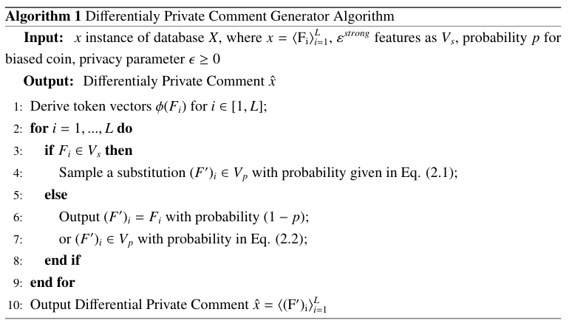
Implementation Methodology

Slide 20
Implementation Methodology
Step 3- Checking similarity of Original Comment and Differentialy Private Comment
We check the similarity between Original Comment and Differentialy comments to check how much meaning preserved of new comments

Slide 21
Experiments
Dataset
We used dataset of Facebook comments which authors used in FOX paper [7]
It contains 4509 user profiles associated with their associated pictures.
Total 190,104 number of comments, 102,884 for male and 87,220 for females.

Slide 22
Experiments
Step 1- Extracting strong features
Fine tuned BERT (bert-base-cased) model to infer gender of user.
Fine tuned BERT model followed by a several fully connected layers with dropout layers.
Split dataset into 80:20 for training and testing and trained the BERT Model
Next, using BERT classifier h and LIME explainaibility tool we extract the strong words ε^{strong}.

Slide 23
Experiments
Step 2 – Generating Differentialy Private Comments
For standard database we use Glove Wiki Giga Word (V_{g}) as standard database.
Protecting tokens are V_{g} – V_{s} and remaining tokens are unprotected tokens.
Then, we generate Differentialy Private Commets using algorithm.

Slide 24
Experiments
Step 3 – Checking similarity of Original Comment and Differentialy Private Comment
For checking similarity we use sentence transformers bert base nli mean tokens model.
It first converts Original Comments and Differentialy Private Comments into Sentence vectors S_{x} and S_{x’}
Now, we check the sentence similarity between S_{x} and S_{x’} using cosine similarity.

Slide 25
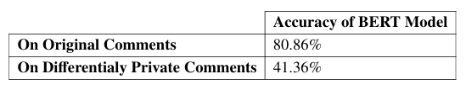
Results
For BERT classifier we got 80.86% training accuracy and 75% test accuracy
After applying Differentialy Private comments we got 41.36% accuracy
For checking similarity we got average 0.9059 similarity score
85.26% times similarity score is greater than 0.8 and 66.55% times similarity score is greater than 0.9
Figure: Accuracy of BERT Model

Slide 26
Conclusion and Future Work
In the results we seen that our Posting Comments Under Differential Privacy approach successfully able to fool gender classifiers by reducing accuracy to 41.36%.
Most of the time it will retain the meaning of the Original Comments.
For future work, we aim to apply our approach on other machine learning models apart from BERT.
Additionally we aim to enhance sentence similarity by using context words during the modification of strong features.

Slide 27
References
G. Beigi and H. Liu, “A survey on privacy in social media: Identification, mitigation, and applications,” ACM/IMS Trans. Data Sci., vol. 1, no. 1, mar 2020.
R. Dey, C. Tang, K. Ross, and N. Saxena, “Estimating age privacy leakage in online social networks,” in 2012 proceedings ieee infocom. IEEE, 2012, pp. 2836–2840.
U. Weinsberg, S. Bhagat, S. Ioannidis, and N. Taft, “Blurme: Inferring and obfuscating user gender based on ratings,” in Proceedings of the sixth ACMconference on Recommender systems, 2012, pp. 195–202.
N. Z. Gong and B. Liu, “Attribute inference attacks in online social networks,” ACM Transactions on Privacy and Security (TOPS), vol. 21, no. 1, pp. 1–30, 2018.
B. A. Pijani, A. Imine, and M. Rusinowitch, “Online attacks on picture owner privacy,” in Database and Expert Systems Applications: 31st International Conference, DEXA 2020, Bratislava, Slovakia, September 14–17, 2020, Proceedings, Part II 31. Springer, 2020, pp. 33–47.
X. Yue, M. Du, T. Wang, Y. Li, H. Sun, and S. S. Chow, “Differential privacy for text analytics via natural text sanitization,” arXiv preprint arXiv:2106.01221, 2021.
N. Belhadj-Cheikh, A. Imine, and M. Rusinowitch, “Fox: Fooling with explanations: Privacy protection with adversarial reactions in social media,” in 2021 18th International Conference on Privacy, Security and Trust(PST). IEEE, 2021, pp. 1–10.
T. Le, S. Wang, and D. Lee, “Malcom: Generating malicious comments to attack neural fake news detection models,” in 2020 IEEE International Conference on Data Mining (ICDM). IEEE, 2020, pp. 282–291.
J. Li, S. Ji, T. Du, B. Li, and T. Wang, “Textbugger: Generating adversarial text against real-world applications,” arXiv preprint arXiv:1812.05271, 2018.
A. Mathai, S. Khare, S. Tamilselvam, and S. Mani, “Adversarial black box attacks on text classifiers using multi-objective genetic optimization guided by deep networks,” arXiv preprint arXiv:2011.03901, 2020.

Slide 28
Thank You

